Slide 1


Big Data
Mohammad Amin Nikbakht
Electrical & Computer Department
Isfahan University Of Technology
Notes:
Introduce your self ,and say thank you!

Slide 2
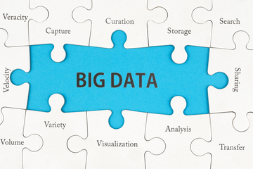

Agenda
What is Big Data?
What is Hadoop?

Slide 3
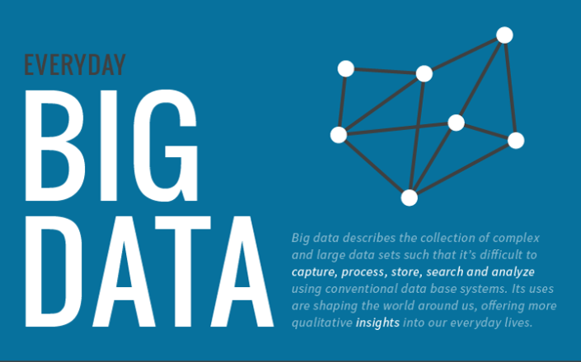
Big Data
Notes:
Facebook users upload 350 million new photos every day. Facebook genereate 4 differents size of each photo → 357 peta bytes.
New York stock exchange .
Peta byte = 10 ^ 15 bytes
Zetta bytes = 10 ^ 21 bytes.

Slide 4
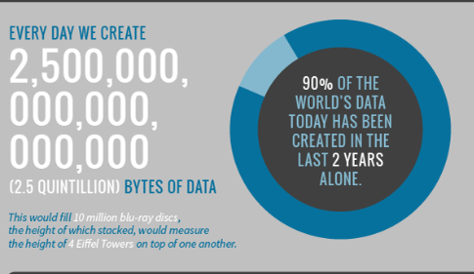
Big Data
Notes:
It is predicated that more TB data will be used for the commercial analysis. The large quantity of the TB data can be called "large dataset". According to the statement of IDC Company, the utilization of data will increase by forty-four times, and the world’s data amount will reach 35.2ZB. The file size of the single dataset will also increase, which is easy for the analysis and understand comprehension of them.

Slide 5
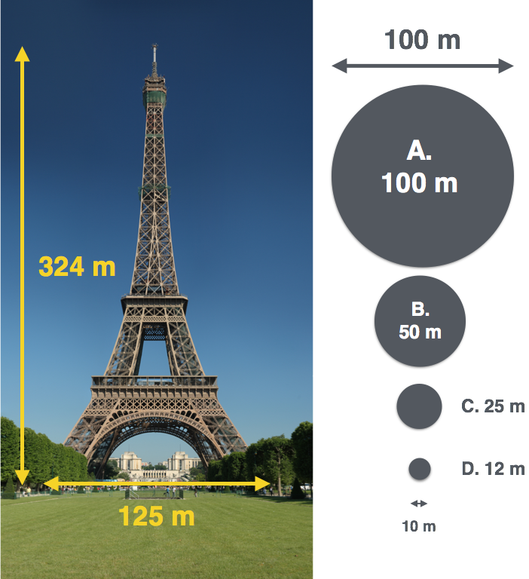
Big Data
Notes:
It is predicated that more TB data will be used for the commercial analysis. The large quantity of the TB data can be called "large dataset". According to the statement of IDC Company, the utilization of data will increase by forty-four times, and the world’s data amount will reach 35.2ZB. The file size of the single dataset will also increase, which is easy for the analysis and understand comprehension of them.

Slide 6
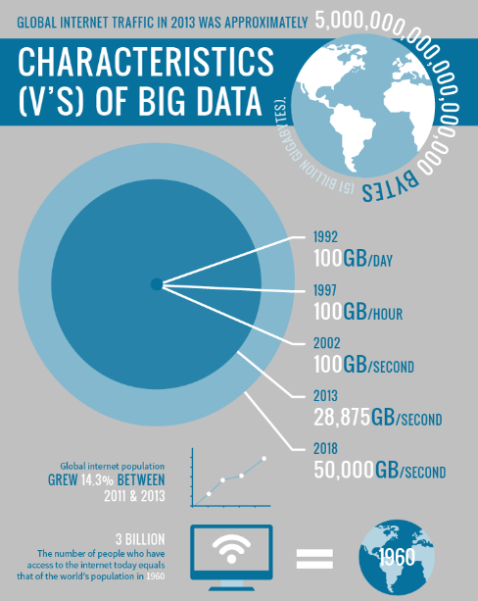
Big Data
Notes:
It is predicated that more TB data will be used for the commercial analysis. The large quantity of the TB data can be called "large dataset". According to the statement of IDC Company, the utilization of data will increase by forty-four times, and the world’s data amount will reach 35.2ZB. The file size of the single dataset will also increase, which is easy for the analysis and understand comprehension of them.

Slide 7
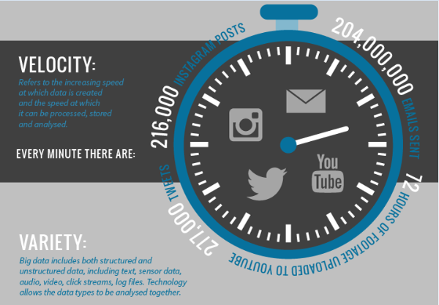
Big Data
Notes:
It is predicated that more TB data will be used for the commercial analysis. The large quantity of the TB data can be called "large dataset". According to the statement of IDC Company, the utilization of data will increase by forty-four times, and the world’s data amount will reach 35.2ZB. The file size of the single dataset will also increase, which is easy for the analysis and understand comprehension of them.

Slide 8

Big Data
Notes:
It is predicated that more TB data will be used for the commercial analysis. The large quantity of the TB data can be called "large dataset". According to the statement of IDC Company, the utilization of data will increase by forty-four times, and the world’s data amount will reach 35.2ZB. The file size of the single dataset will also increase, which is easy for the analysis and understand comprehension of them.

Slide 9

How does BIG DATA improve our daily lives ?
Notes:
It is predicated that more TB data will be used for the commercial analysis. The large quantity of the TB data can be called "large dataset". According to the statement of IDC Company, the utilization of data will increase by forty-four times, and the world’s data amount will reach 35.2ZB. The file size of the single dataset will also increase, which is easy for the analysis and understand comprehension of them.

Slide 10
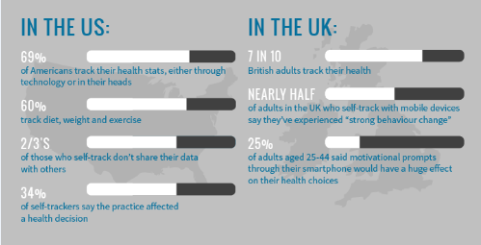
How does BIG DATA improve our daily lives ?
Notes:
It is predicated that more TB data will be used for the commercial analysis. The large quantity of the TB data can be called "large dataset". According to the statement of IDC Company, the utilization of data will increase by forty-four times, and the world’s data amount will reach 35.2ZB. The file size of the single dataset will also increase, which is easy for the analysis and understand comprehension of them.

Slide 11
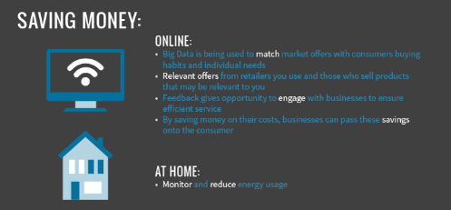
How does BIG DATA improve our daily lives ?
Notes:
It is predicated that more TB data will be used for the commercial analysis. The large quantity of the TB data can be called "large dataset". According to the statement of IDC Company, the utilization of data will increase by forty-four times, and the world’s data amount will reach 35.2ZB. The file size of the single dataset will also increase, which is easy for the analysis and understand comprehension of them.

Slide 12
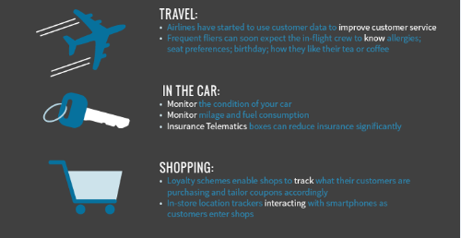
How does BIG DATA improve our daily lives ?
Notes:
It is predicated that more TB data will be used for the commercial analysis. The large quantity of the TB data can be called "large dataset". According to the statement of IDC Company, the utilization of data will increase by forty-four times, and the world’s data amount will reach 35.2ZB. The file size of the single dataset will also increase, which is easy for the analysis and understand comprehension of them.

Slide 13
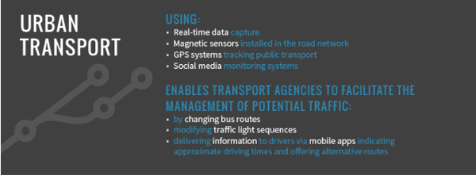
How does BIG DATA improve our daily lives ?
Notes:
It is predicated that more TB data will be used for the commercial analysis. The large quantity of the TB data can be called "large dataset". According to the statement of IDC Company, the utilization of data will increase by forty-four times, and the world’s data amount will reach 35.2ZB. The file size of the single dataset will also increase, which is easy for the analysis and understand comprehension of them.

Slide 14

How does BIG DATA improve our daily lives ?
Notes:
It is predicated that more TB data will be used for the commercial analysis. The large quantity of the TB data can be called "large dataset". According to the statement of IDC Company, the utilization of data will increase by forty-four times, and the world’s data amount will reach 35.2ZB. The file size of the single dataset will also increase, which is easy for the analysis and understand comprehension of them.

Slide 15

Hadoop!
Ask bigger questions.

Slide 16


Timeline
Dec 2004: Dean/Ghemawat (Google) MapReduce paper
2005: Doug Cutting and Mike Cafarella (Yahoo) create Hadoop, at first only to extend Nutch
Notes:
Apache Nutch is a highly extensible and scalable open source web crawler software project.

Slide 17
Timeline
2006: Yahoo runs Hadoop on 5-20 nodes
March 2008: Cloudera founded
July 2008: Hadoop wins TeraByte sort benchmark (1st time a Java program won this competition)
April 2009: Amazon introduce “Elastic MapReduce” as a service on S3/EC2
June 2011: Hortonworks founded

Slide 18
Timeline
27 dec 2011: Apache Hadoop release 1.0.0
June 2012: Facebook claim “biggest Hadoop cluster”, totalling more than 100 PetaBytes in HDFS
2013: Yahoo runs Hadoop on 42,000 nodes, computing about 500,000 MapReduce jobs per day
15 oct 2013: Apache Hadoop release 2.2.0 (YARN)

Slide 19
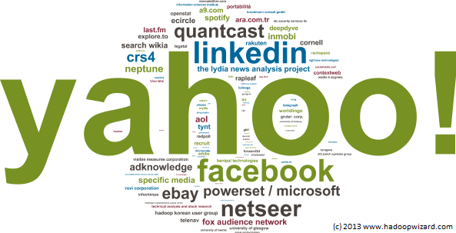
Who uses Hadoop?

Slide 20


What is hadoop?
Open sourced, flexible and available architecture for large scale computation and data processing on a network of commodity hardware
Inspired by

Slide 21

Hadoop amazing name!

Slide 22
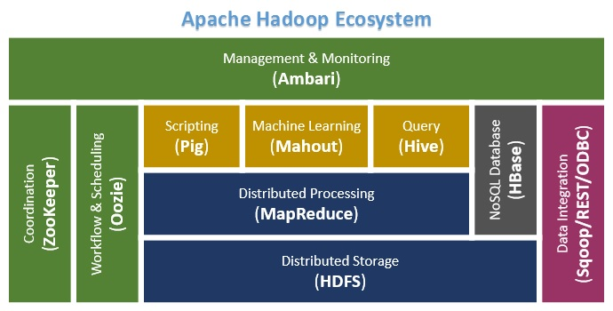
Hadoop Ecosystem!
Scaloop

Slide 23
Hadoop core
MapReduce
HDFS

Slide 24
Hadoop core
MapReduce
JAVA
JAVA
HDFS

Slide 25

What is HDFS?
Hadoop Distributed File System
Redundancy
Fault Tolerant
Scalable
Self Healing
Write Once, Read Many Times
Java API
Command Line Tool
Notes:
HDFS follows the write-once, read-many approach for its files and applications. It assumes that a file in HDFS once written will not be modified, though it can be access ‘n’ number of times (though future versions of Hadoop may support this feature too)! At present, in HDFS strictly has one writer at any time. This assumption enables high throughput data access and also simplifies data coherency issues. A web crawler or a MapReduce application is best suited for HDFS.
As HDFS works on the principle of ‘Write Once, Read Many‘, the feature of streaming data access is extremely important in HDFS. As HDFS is designed more for batch processing rather than interactive use by users. The emphasis is on high throughput of data access rather than low latency of data access. HDFS focuses not so much on storing the data but how to retrieve it at the fastest possible speed, especially while analyzing logs. In HDFS, reading the complete data is more important than the time taken to fetch a single record from the data. HDFS overlooks a few POSIX requirements in order to implement streaming data access.

Slide 26

Map Reduce
Is a framework for performing high performance distributed data processing using the divide and aggregate programming paradigm.

Slide 27

Simple example
Goal: count the number of books in the library.
Map: You count up shelf #1, I count up shelf #2
(The more people we get, the faster this part goes)
Reduce: We all get together and add up our individual counts.
(Cf. http://www.chrisstucchio.com/blog/2011/mapreduce_explained.html)

Slide 28
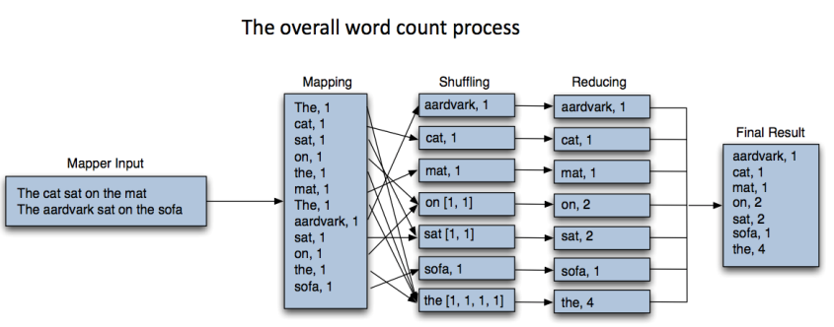
Routine example
Key: offset
Value: line
Key: word
Value: count
Key: word
Value: sum of count
0:The cat sat on the mat
1:The aardvark sat on the sofa

Slide 29
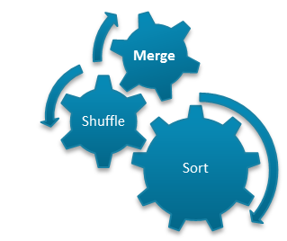
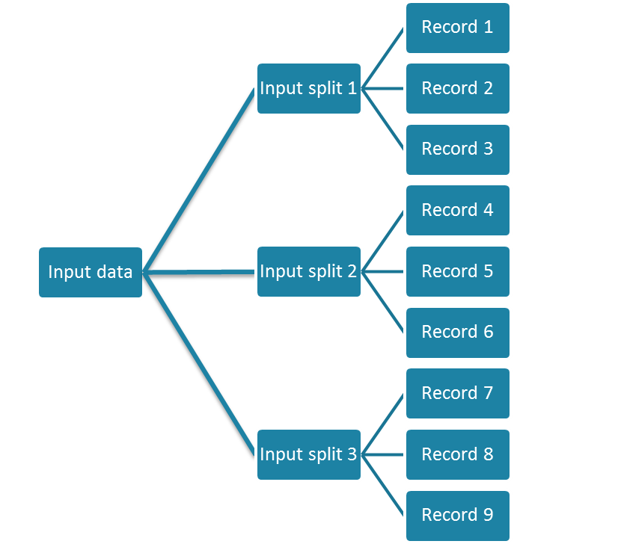
MapReduce in a nutshell
Task1
Aggregated Result
Task 2
Output data
Aggregated Result
Task 3
© Sven Schlarb

Slide 30
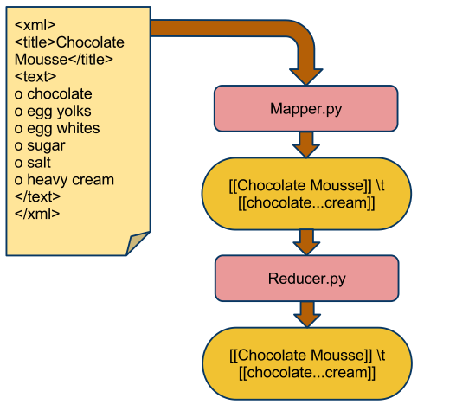
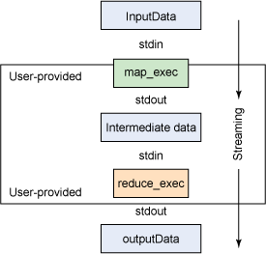
Hadoop streaming

Slide 31
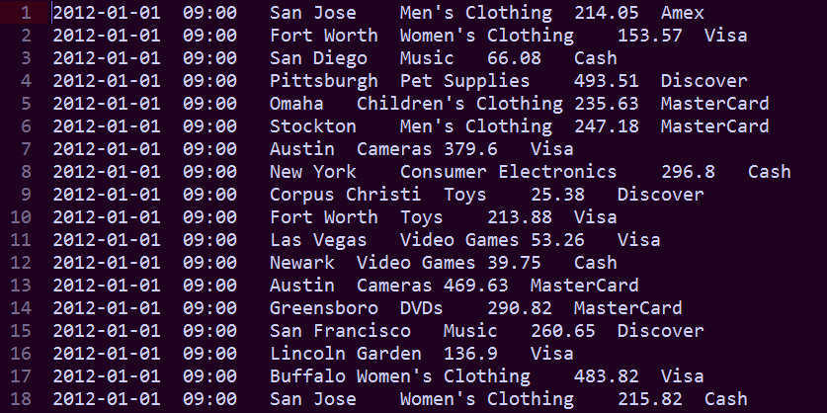
Exercise
Goal : find total sales of each city!

Slide 32
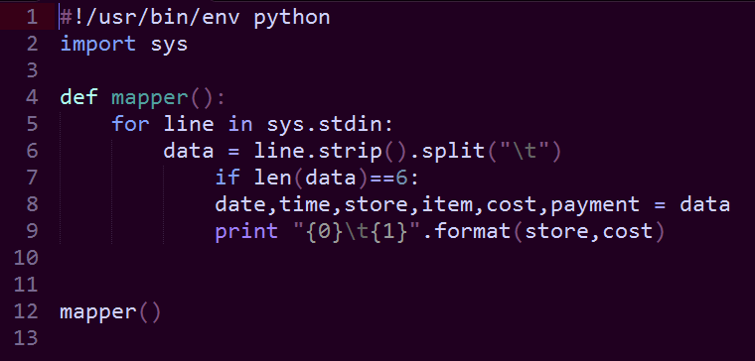
Mapper

Slide 33
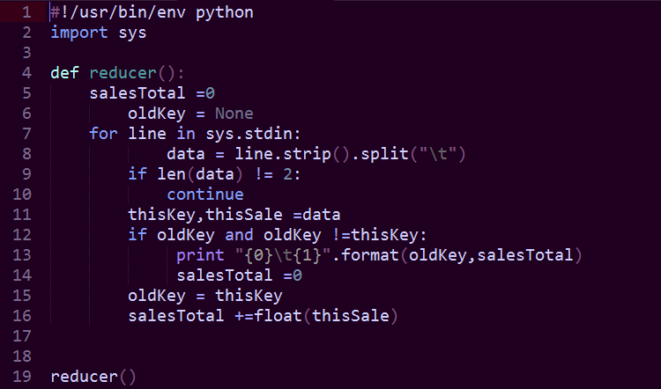
Reducer

Slide 34

Scaloop Story

Slide 35

Resources
Tom White: Hadoop. The Definitive Guide
Udacity Big Data course
www.vcloudnews.com

Slide 36
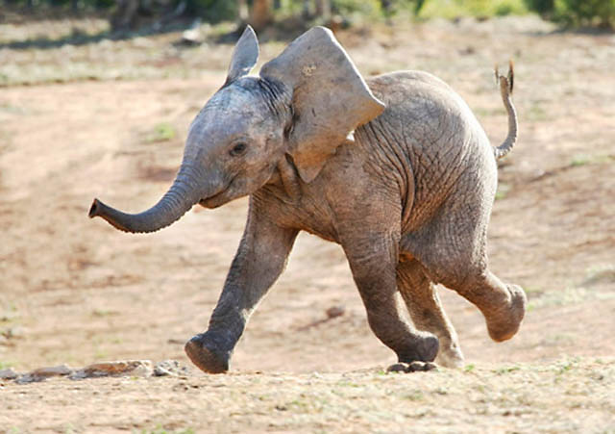
Questions?

